Slide 1
2018TAX REFORM

Slide 2
Thank You!!!!! 24 out of 83 members!!!
Greg Lard – Woof Gang Geoff Repella – Byrd Cookie
Chuck Brown – Infinity Drexel Taylor – Omega Steel
Malcomb Butler – Fiduciary Group Paul Coggins – Coggins Promotional
Tim Cooper – Limbs & Things John Shealy – J&L Glass
Rhett Willis – DJ Powers Wes Dorman – Champion Fire
Peter Thacher – Vaden Vernon Buchman – Merrill Lynch
Zeke Gaines – Real estate ventures Hugh Barnes – Barnes resaurants
Greg Sedlock – Jerry Beets Chris Sywassink – Ghost Coast
Drew Ambos – Ambos Seafoods
Drew Ernst – Hunter Maclean
Ray Gaster – Gaster Lumber
Mike Traynor – Savannah Morning News
Houston Demere- Colonial/Enmark
Al Kennickell – Kennickell Printing
Mark Mobley – EMC
Bill Taylor – Real estate ventures

Slide 3
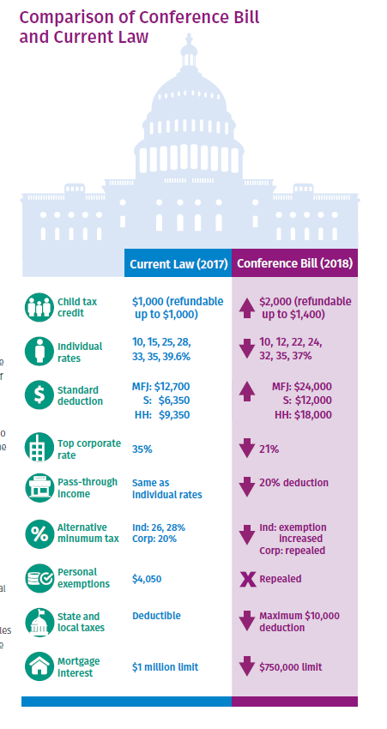
Overview

Slide 4
Ordinary Income Tax Rates
The current seven tax bracket system is retained, but the rates are lowered for all taxpayers and the thresholds are adjusted.
Tax Rate | Married Filing Jointly | Single | Head of Household | Married Filing Separately | Estates & Trusts
10% | $0 - $19,050 | $0 - $9,525 | $0 - $13,600 | $0 - $9,525 | $0 - $2,550
12% | $19,050 - $77,400 | $9,525 - $38,700 | $13,600 - $51,800 | $9,525 - $38,700 | N/A
22% | $77,400 - $165,000 | $38,700 - $82,500 | $51,800 - $82,500 | $38,700 - $82,500 | N/A
24% | $165,000 - $315,000 | $82,500 - $157,500 | $82,500 - $157,500 | $82,500 - $157,500 | $2,550 - $9,150
32% | $315,000 - $400,000 | $157,500 - $200,000 | $157,500 - $200,000 | $157,500 - $200,000 | N/A
35% | $400,000 - $600,000 | $200,000 - $500,000 | $200,000 - $500,000 | $200,000 - $300,000 | $9,150 - $12,500
37% | Over $600,000 | Over $500,000 | Over $500,000 | Over $300,000 | Over $12,500

Slide 5
Standard Deduction & Personal Exemptions
In general, effective on January 1, 2018 and expire after December 31, 2025
Standard deduction is increased to the following amounts (indexed for inflation in future years):
Married Filing Jointly: $24,000
Head-of-Household: $18,000
All Other Taxpayers: $12,000
Child Tax Credit doubled from $1,000 to $2,000 per qualifying child. Phaseout increased to AGI of $400,000 for joint filers ($200,000 for all others).
The personal exemption is suspended through tax year 2025.
The exemption for estates and trusts remains at $100 (complex), $300 (simple), $600 (estates).

Slide 6
Individuals
Estate and Gift Taxes: The exemption for estate and gift tax more than doubled from $5MM to $11MM estate and gift exemption starting in 2018 - $22 million for a married couple.
$15,000 per year tax free to any recipient ($30,000 per married couple) does not count towards the cap
Kiddie Tax - Tax on children's income will have two different tax regimes for their earned and unearned income:
Earned Income: Taxed at the rates applied to single filers.
Unearned Income: Taxed at ordinary income and preferential rates (i.e., capital gains and qualified dividends) applied to trusts and estates. Children will no longer be subject to their parents’ tax rate. Unearned ordinary income exceeding $12,500 is taxed at 37%.

Slide 7
Above-the-Line Deductions
Moving Expenses: Suspended through tax year 2025; however, still available for members of the U.S. Military who move pursuant to a military order.
Alimony: Effective for divorce or separation agreements entered into after December 31, 2018:
Deduction for alimony payments and inclusion in income by the recipient is repealed.
Existing alimony or separate maintenance agreements are grandfathered, as are modifications to existing agreements.

Slide 8
Itemized Deductions
Medical Expenses – The AGI threshold is lowered to 7.5% for all taxpayers for tax years 2017 and 2018.
State and Local Taxes – Taxpayers are permitted a maximum $10,000 deduction on the sum of:
(i) state and local real property taxes,
(ii) state and local personal property taxes, and
(iii) state and local income taxes (or sales tax, if elected).
Mortgage Interest – Taxpayers are permitted to deduct the interest paid on acquisition indebtedness of up to $750,000.
Debt incurred on or before December 15, 2017 is grandfathered under the previous law of interest paid on acquisition indebtedness of up to $1,000,000.
Home Equity Interest – The deduction for interest paid on home equity indebtedness is suspended.
“Pease” Limitation – Repeals the overall limitation on itemized deductions through 2025.

Slide 9
Itemized Deductions (continued)
Charitable Contributions – Three modifications:
Cash contributions to public charities now have a 60% of AGI limitation (previously it was 50%).
Denial of charitable deduction for payments made in exchange for athletic seating rights (previously able to deduct 80% of amounts paid).
Removal of substantiation exception for certain contributions reported by the charitable organization.
Casualty Losses – Suspended through tax year 2025, unless the loss is attributable to a Federally declared disaster loss.
If a taxpayer has a personal casualty loss gain, they may deduct personal casualty losses not attributable to a Federal declared disaster loss in the amount equal to no more than the personal casualty loss gain.
Miscellaneous Itemized Deductions Subject to 2% floor - These have been suspended and include investment fees and expenses, tax preparation fees, and unreimbursed business expenses, among others.

Slide 10
Alternative Minimum Tax (AMT)
The individual AMT has been retained.
The exemption amounts have been increased to the following thresholds:
Joint Filers: $109,400 ($54,700 for MFS)
All other Filers: $70,300
The exemption phase-out thresholds are increased to:
Joint Filers: $1,000,000
All other Filers: $500,000
Trusts and Estates – Remains unchanged

Slide 11
Other Changes for Individuals
Carried Interest holding period for long-term capital gain changed to three years with respect to certain partnership interests.
Affordable Care Act shared responsibility payment reduced to $0 after 2018.
Roth IRA conversion recharacterizations are no longer allowed.
Child Tax Credit doubled from $1,000 to $2,000 per qualifying child. Phaseout increased to AGI of $400,000 for joint filers ($200,000 for all others).
529 savings accounts are expanded to K-12 tuition in addition to college tuition.
Business Losses and NOLs have additional annual and carryover limitations. NOLs can only be carried forward. IF you filed 2017 with a LOSS – CARRY IT BACK NOW!!

Slide 12
Individual Tax Illustration

Slide 13
Corporations and Business Income
Corporations
Changes are permanent for C corporations.
Tax Rates: 21% flat rate effective for taxable years beginning after December 31, 2017.
Replaces graduated corporate tax rates, which taxed income over $10MM at 35%
Corporate AMT is repealed.
Depreciation
Bonus Depreciation under 168(k) allows for 100% deduction of the cost of new or used eligible property purchase after September 27, 2017.
Phased out 20% per year starting in 2023.
Section 179 Expensing allows up to $1MM deduction of the cost of eligible property against taxable income.

Slide 14
Corporations and Business Income (cont.)
Expenses and Deductions
Interest Deduction Limitation: The deduction for business interest is limited to the sum of:
Business Interest Income
30% of the taxpayer’s adjusted taxable income
Net Operating Losses (NOLs): NOL deduction limited to 80% of taxable income without regard to the NOL.
NOLs can carry forward indefinitely. Can no longer be carried back.
Like-kind Exchanges: No longer allowed for personal property (e.g., furniture and equipment).
Domestic Production Activity Deduction: repealed
Entertainment Expenses: Deductions for entertainment expenses are disallowed. This includes Membership dues for any club organized for business, pleasure, recreation or other social purposes.

Slide 15
Corporations and Business Income (cont.)
Other Changes
Accounting Methods: Generally for businesses with less than $25MM average annual gross receipts in a 3-year period:
Cash method of accounting
Simplified inventory accounting
Exempted from 263A UNICAP rules
Partnership Technical Terminations: Repealed
Tax Credits, Compensation and Foreign Income

Slide 16
Partnerships and Pass Through Entities
Section 199A Deduction for Qualified Business Income QBI -
What types of income are considered "pass-through?"
Section 199A of the newly updated U.S. tax code allows owners of certain types of pass-through businesses to deduct as much as 20% of their business income. Generally speaking, this includes most business income not derived from ownership in a corporation which includes (but isn't necessarily limited to):
Income from a sole proprietorship
Income from an LLC or S-corporation
Partnership income
Income from rental properties (Including income passed through from REITs)
Any S-corporation, partnership, or trust that owns an interest in another pass-through business.

Slide 17
Partnerships and Pass Through Entities
Section 199A Deduction for Qualified Business Income QBI -
What types of income IS NOT considered "pass-through?"
owners of "specified service businesses" cannot use the pass-through deduction if their income exceeds certain thresholds. This list provided by the IRS includes businesses that perform services the following fields:
Health -- including doctors, pharmacists, nurses, dentist, and more.
Law -- specifically lawyers, paralegals, legal arbitrators, and mediators.
Accounting
Actuarial science
Performing arts -- However, broadcasters are generally excluded.
Consulting
Athletics
Financial services -- such as financial advisors, investment managers, and investment bankers.
Brokerage services -- This only has to do with securities. Real estate brokers, for example, are excluded.
Trading businesses dealing in securities, partnership interests, or commodities
Any trade or business where the "principal asset ... is the reputation or skill of one or more of its employees or owners."

Slide 18
Partnerships and Pass Through Entities
Section 199A Deduction for Qualified Business Income QBI -
20% of all pass through income is deductible up to limits:
taxpayer’s taxable income does not exceed $315,000 (joint filer) or $157,500 (other filers), subject to full phase-in at $415,000 and $207,500, respectively.
The deduction attributable to 20% of the taxpayer’s QBI cannot exceed the greater of (A) 50% of W-2 wages paid with respect to the QBI or (B) The sum of 25% of W-2 wages plus 2.5% of the unadjusted basis of qualified property (depreciable property on hand).

Slide 19
Tax Saving Ideas – NOW!!!
Buy equipment – deduct in 2018
Prepay expenses for 2019
Legitimate tax savings opportunities –
State - Low income housing credits
State - Historic renovation credits
Fed and State - Conservation easement deductions
State - Film tax credits
State credits allocations
Student Scholarship organizations like Georgia Goal and Grace Scholars
Regional hospital donation credits
R&D tax credit study
Cost Segregation Study
Work Opportunity and Jobs tax credits
Did you take the 2017 Hurricane Credit – if you qualify and did not take it - go back and Amend

Slide 20
Questions?

